Slide 1


Samba Commerce
Data Visualizations
Tableau Assignment milestone 1 & 2
Syihab Agung Satriotomo
https://public.tableau.com/views/W10W11_MAY23_Syihab_AgungSatriotomo/TotalOrderperMonth?:language=en-US&publish=yes&:display_count=n&:origin=viz_share_link

Slide 2




Main Objective & Key Result
Create chart of analysis of Company-wide dashboard with theme transactions to make better business performance and understand more Metrics from the data.
Who are the users?
CEO of Samba Commerce as users
Other executives can also use dashboard for other purposes
Why does the user need the worksheet?
They need the to get information which has relation with transactions that has insight from the worksheet / visualizations.
How does the user use the worksheet?
Using the chart and data visualizations to inform the data and findings any information about this year transaction. From that users can make meeting with financial, administration, and supplier team so CEO could make better business performance for the next year.

Slide 3
Creating Visualizations and Dashboard
1.
Understand Business & Define Visualizations object
2.
Import, Join & Prepare Datasets
Users: CEO and other executives
Why? They need to get the information about transaction from chart of analysis of Company-wide Dashboard
First Import the data, check the data if there is cleaning data if necessary.
Then join the datasets so we can aggregate across different datasets.
3.
Calculate & Visualize the Metric needed
4.
Layout & Finalize the Dashboards
What we calculated are : We calculate everything we need on assignment brief
After all visualization ready, then we can start layouting the dashboards. We also make filter, grouping and etc. so dashboard more easy to read and interactive.

Slide 4
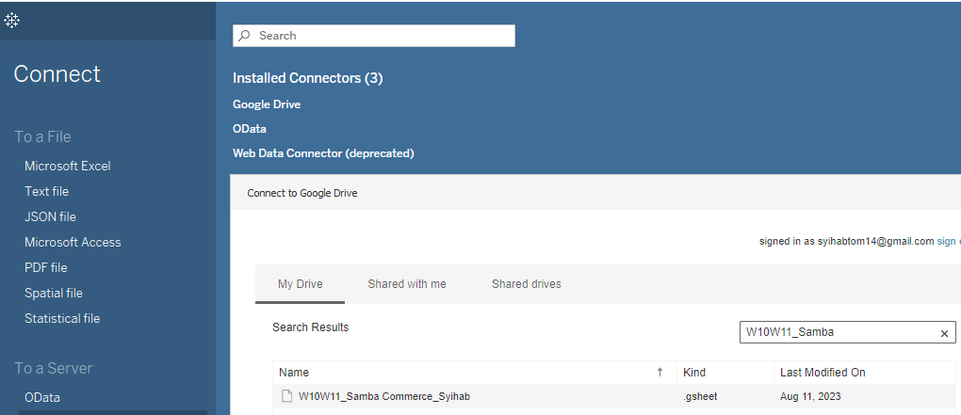
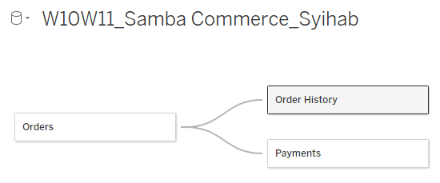
1.Connect the datasets
2.Create the relationship between datasets
First we connect the datasets on tableau to google drive where the datasets has been saved.
Secondly we make relationship between datasets Order to Order History and Payments, why? because on Orders dataset has Primary key “order_id” which lead into Foreign key on “Order History” and “Payments” dataset. Based on that we can make relationship between those datasets.

Slide 5
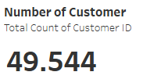

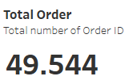

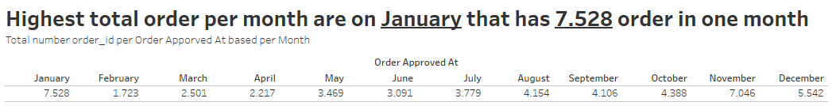
Insight :
Total number of Customer ID are 49.544
Total unique number of Customer ID are 48.022
Total Order of Samba Commerce based on order ID it has 49.544 order in last year.
Unique Number Of seller ID of Samba Commerce are 1.771

Slide 6
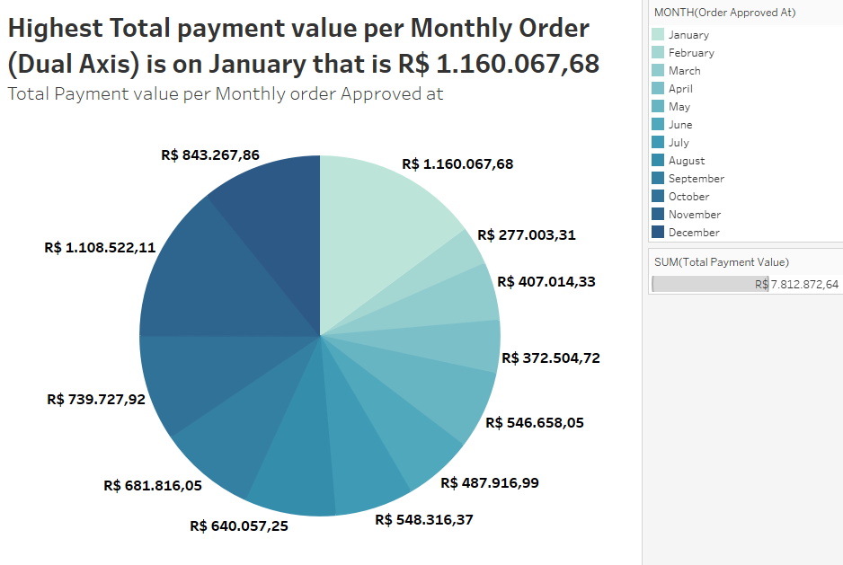
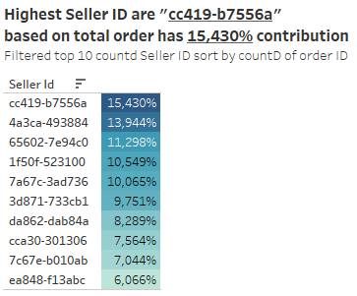

Slide 7
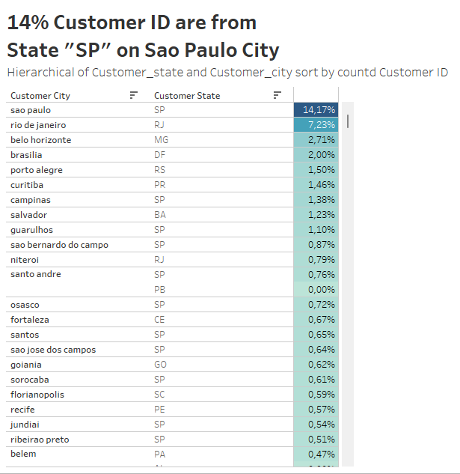
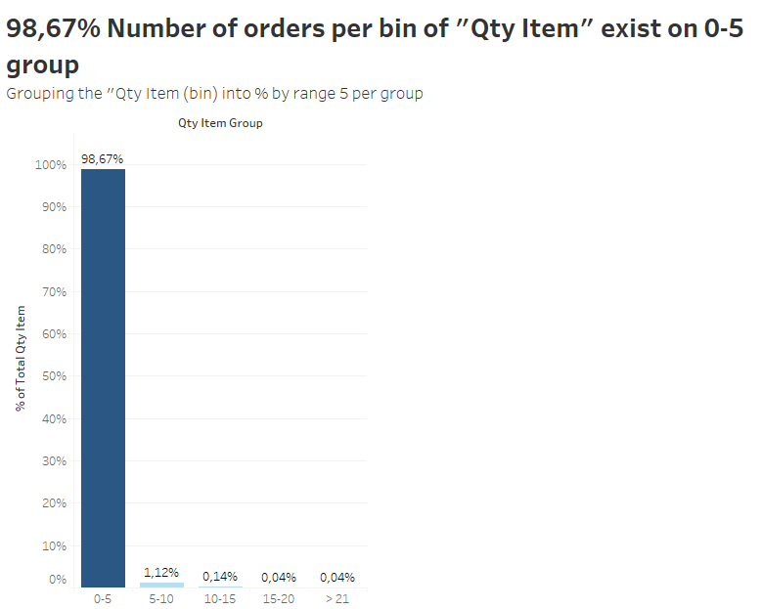
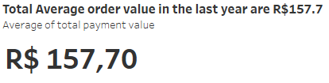
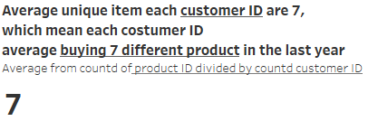
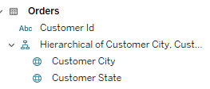

Slide 8
Conclusion :
As Highest order in a year are in November which that day Brazil have to celebrate All Souls day and Republic day which mean that holiday people on Brazil doing high transaction on November and that holiday involve a lot of decoration, All souls day need a lot of candles to celebrate and in Republic day is involve so much decoration because on they held Concert, Parade on the streets to celebrate probably why November have highest order.
Also Highest Total payment value per Month is on January which has R$ 1.160.067,68 probably because they celebrating Ano Novo / Confraternização Universal involving Festivities on 1 January and the second is on November has R$ 1.108.522,11 probably because holiday we mention above.

Slide 9
Milestone 2 Intermediate
https://lookerstudio.google.com/reporting/c9bc6f11-f1de-48b8-b9ec-d143000cbd4d

Slide 10

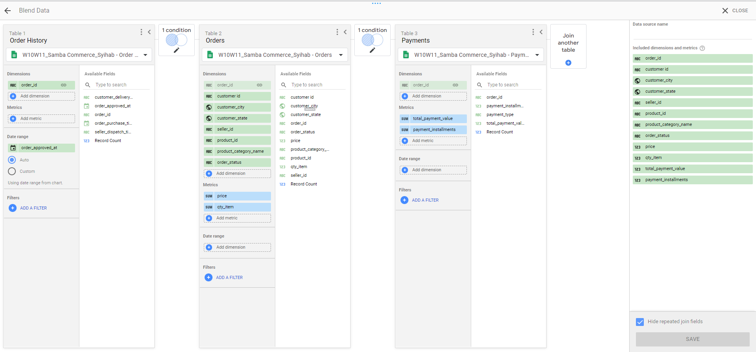
First we Change the data type on Orders sheet customer_city into city and customer_state into Country subdivision (2nd level)
Blend Datasource between Order History, Orders, and Payments using Left join because data range is on Order History table

Slide 11
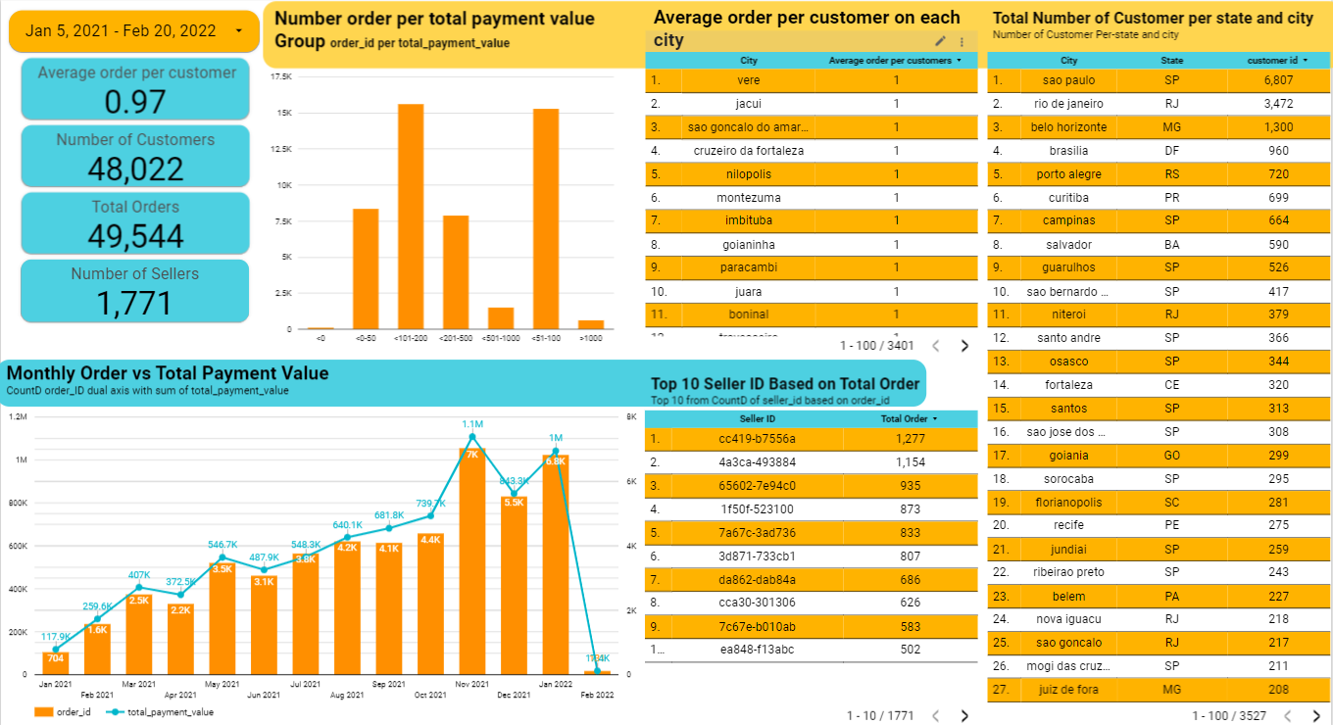

Slide 12
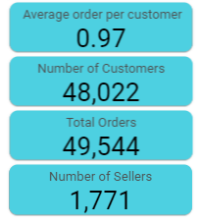
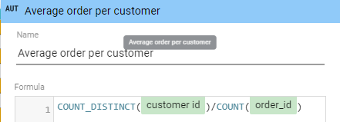
Average order per customer fromula
Insights:
Most of our Customer are live in Sao Paulo city
HIghest Top seller based on order_id are “cc419-b7556a”
Highest order are on 100-200 order_id that reach value around 15K
Average order per customers are 0.97
Total Number per customer 48.022
Total orders from 5 jan 2021 - 20 feb 2022 are 49.544
Total Our Seller are 1.771

